Slide 1
Easy Study Portal
Prepared By: 21IT004-Dharma Bagadia
21IT011-Vatsal Bhatt
21IT012-Riya Bhimani

Slide 2
Aim: To download and upload study materials easily through website.
UN Sustainable Development Goal: Quality Development
Using our website user can download and upload file whenever they want and it they require hard copy he can request to user who has submitted the details.

Slide 3

Starting Page
Here , is the starting page of the user.
There is two option one for the teachers and other is for students.

Slide 4
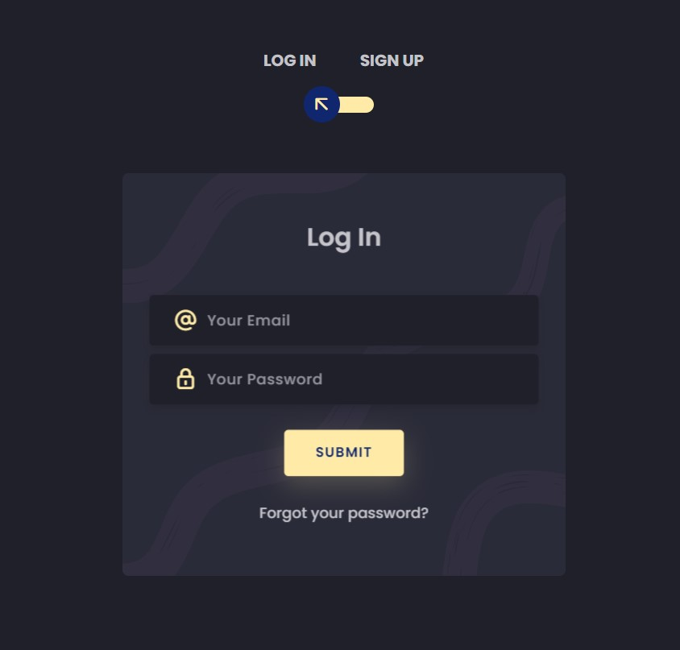
Login Page
Here user will give ID and Password.
If user forgot password then through email
verification he can generate new password.

Slide 5
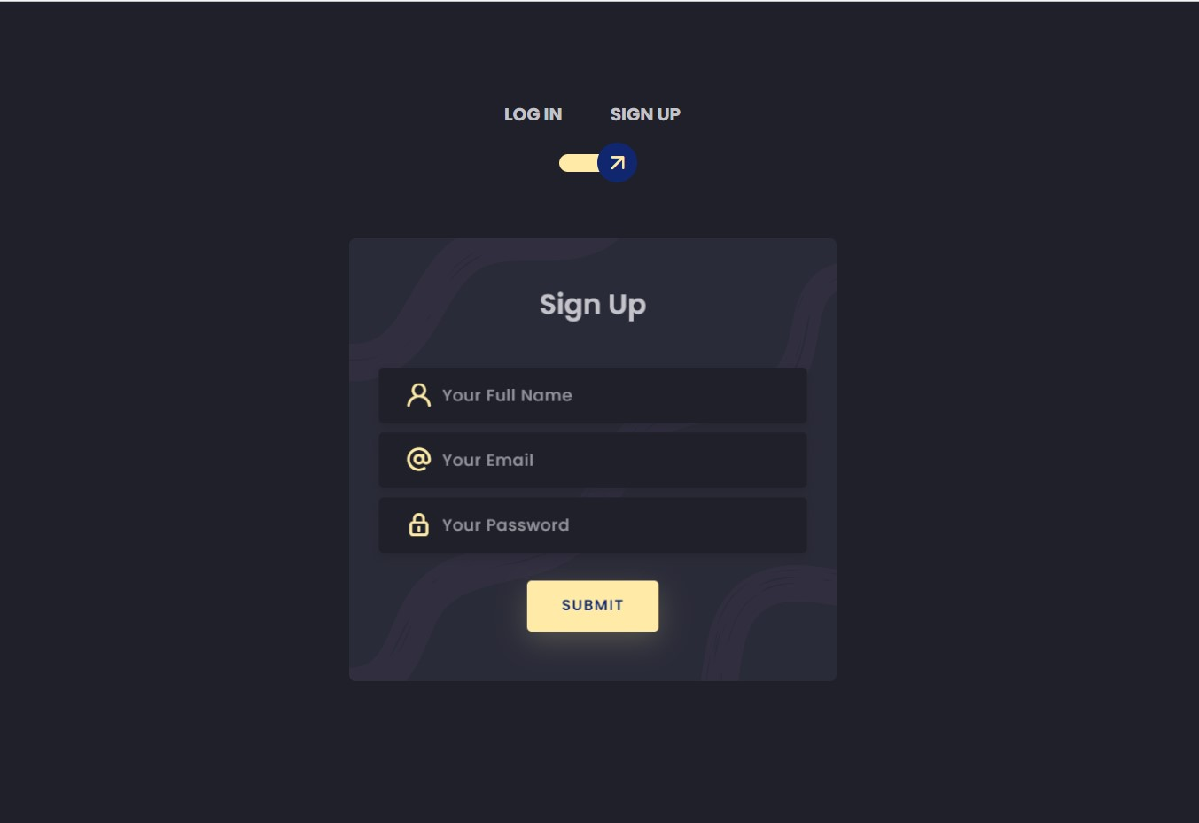
Sign Up
Here user can make new account
by giving name, email and
generate password.

Slide 6
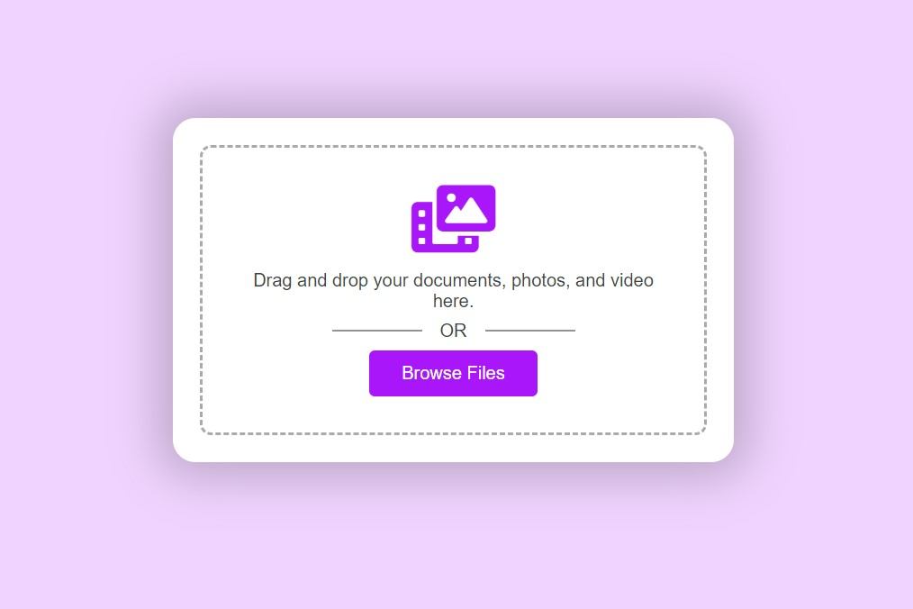
Upload
Here user can upload study materials by drag and drop or by browsing file.

Slide 7
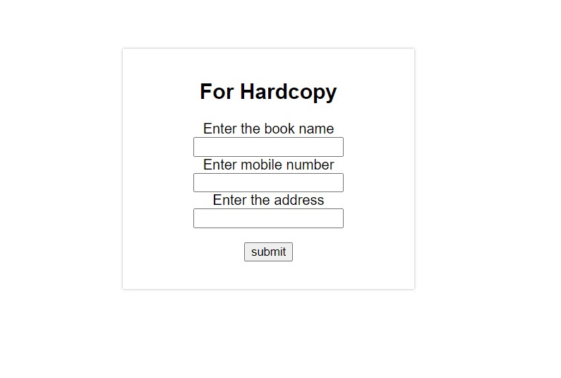
Hardcopy
We Connect buyer and seller of the book by providing their mobile number and address

Slide 8


